Slide 1
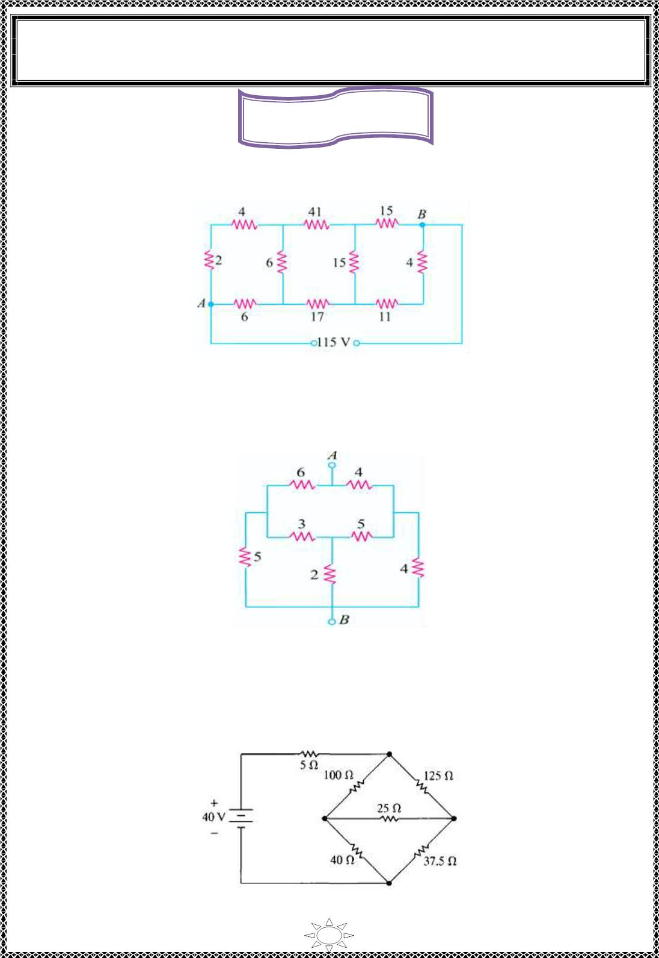
University of Diyala
Engineering College
Electronic Department
Electrical Engineering Fundamentals
1st Class
Asst., Lecturer : Wisam N. AL-Obaidi
Year (2013-2014)
Home Works
H.W.(1):- Find the current in the 17 Ω res istor in the network shown in Figure (2.29) by
using (a) star/delta conversion. [10/3A]
Figure (2 .29 )
H.W.(2):- Determine the resistance between points A and B in the network of Figure
(2.30). [4.23 Ω]
Trail Version
Trail Version
Trail Version
Trail Version
Trail Version
Trail Version
Trail Version
Trail Version
Trail Version
Trail Version
Trail Version
Trail Version
Trail Version
Figure (2.30 )
H.W.(3):- Find the current and power s up p lied by the 40V source in the c ircuit shown in
Figure (2 .31 ). [0 .5 A, 20W]
Figure (2.31 )
31

Slide 2
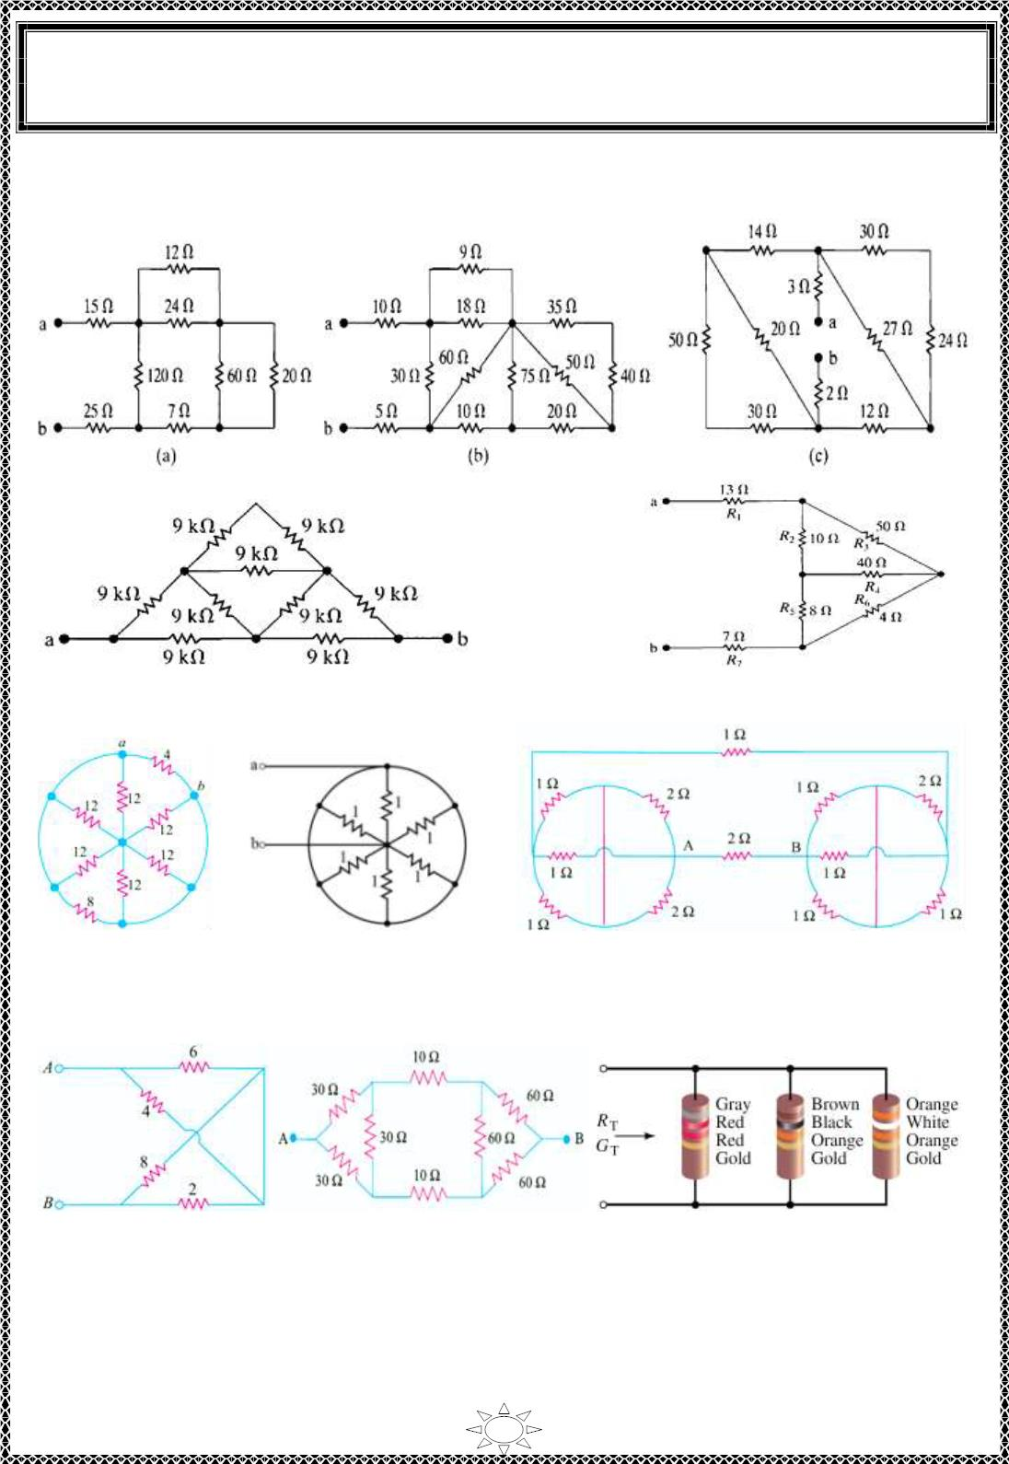
University of Diyala
Engineering College
Electronic Department
Electrical Engineering Fundamentals
1st Class
Asst., Lecturer : Wisam N. AL-Obaidi
Year (2013-2014)
H.W.(4):- Find the equivalent resistance between the terminals a & b in the circuits shown
in Figure (2.32 )(a) to (k ).
Trail Version
Trail Version
Trail Version
Trail Version
Trail Version
Trail Version
Trail Version
Trail Version
Trail Version
Trail Version
Trail Version
Trail Version
Trail Version
(d)
(e)
(f)
(g)
(h)
(i)
(j)
(k)
Figure (2.32 )
[Answer: (a)64Ω, (b)30Ω, (c)20Ω, (d)10 KΩ , (e)33Ω, (f)2Ω, (g)0.168Ω, (h)1.034Ω, (i)
4Ω, (j)50Ω]
32

Slide 3
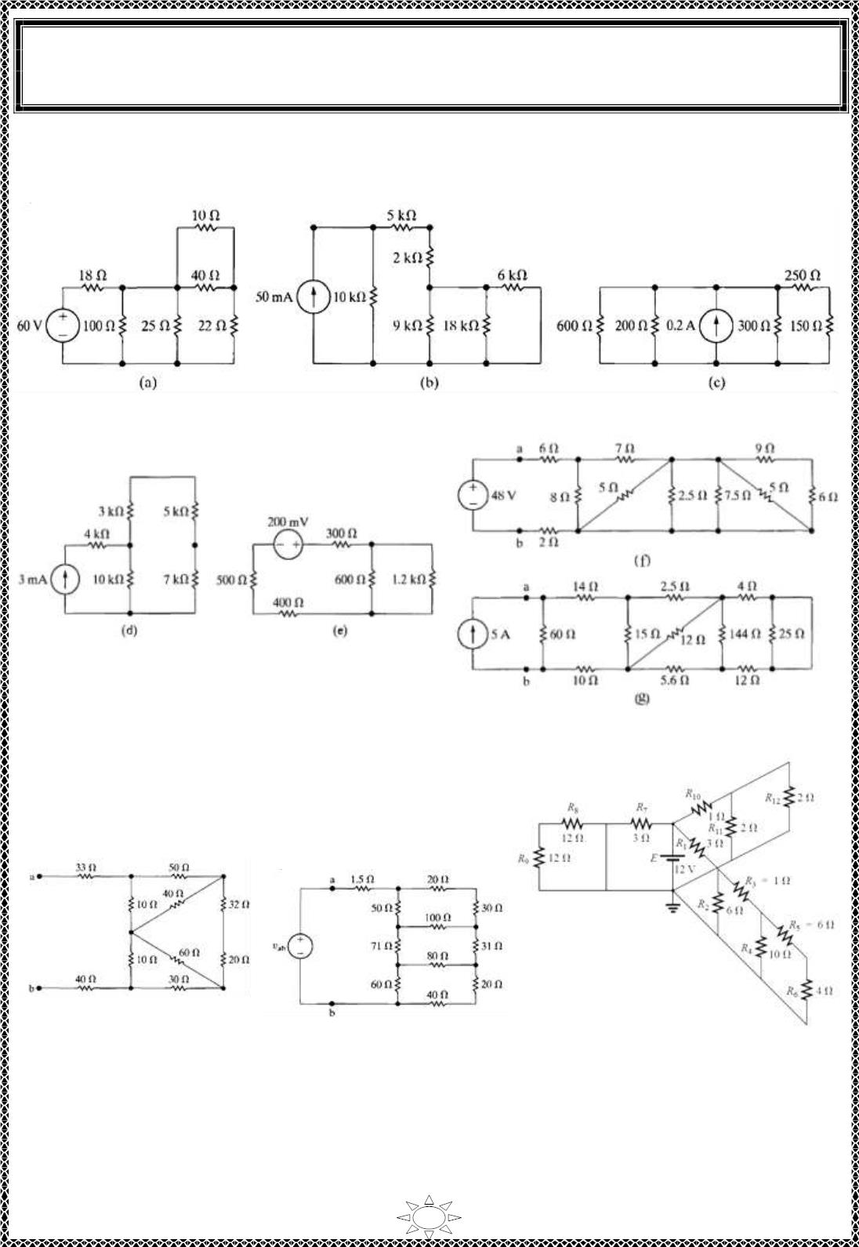
University of Diyala
Engineering College
Electronic Department
Electrical Engineering Fundamentals
1st Class
Asst., Lecturer : Wisam N. AL-Obaidi
Year (2013-2014)
H.W.(5):- Find the equivalent resistance as seen from voltage or current s ources in the
c irc uits shown in Figure (2.33 ) fro m (a) to (j).
Trail Version
Trail Version
Trail Version
Trail Version
Trail Version
Trail Version
Trail Version
Trail Version
Trail Version
Trail Version
Trail Version
Trail Version
Trail Version
(h)
(i)
(j)
Figure (2.33 )
33

Slide 4
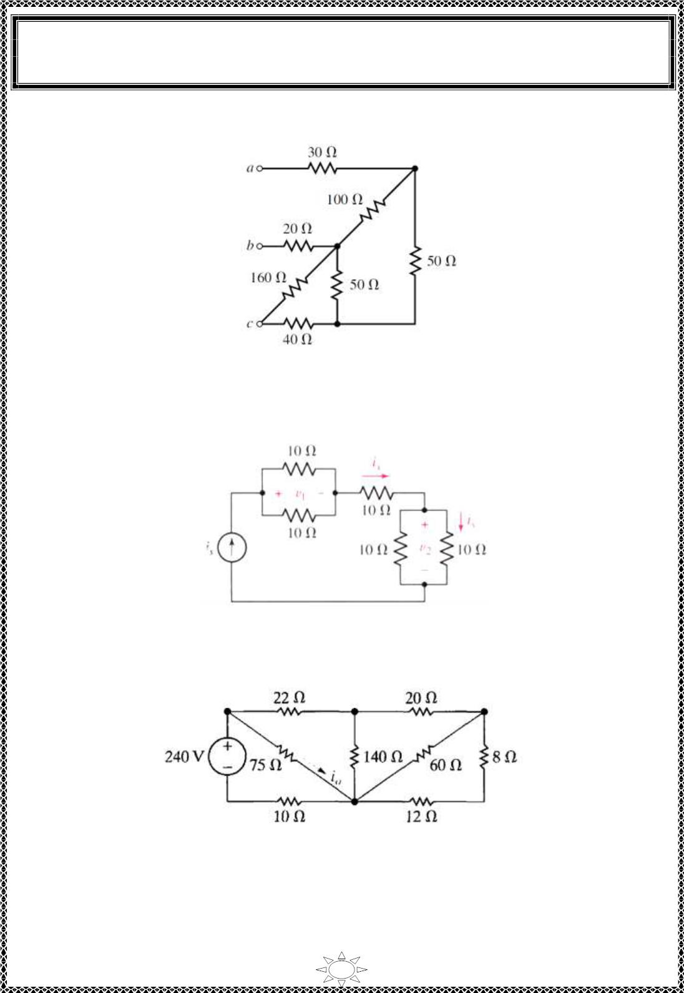
University of Diyala
Engineering College
Electronic Department
Electrical Engineering Fundamentals
1st Class
Asst., Lecturer : Wisam N. AL-Obaidi
Year (2013-2014)
H.W.(6):- Find the equivalent resistance between ter minals (a) a & b (b) a &c (c) b& c, of
c irc uits shown in Figure (2.34).
Figure (2.34 )
[Answer :Rab = 97.4Ω, Rac = 95.88Ω, Rbc = 72.2Ω]
H.W.(7):- For the circuit in Figure (2.35 ), if i = 5A then f ind v , v , i & i .
x
1
2
s
y
Trail Version
Trail Version
Trail Version
Trail Version
Trail Version
Trail Version
Trail Version
Trail Version
Trail Version
Trail Version
Trail Version
Trail Version
Trail Version
Figure (2.35 )
H.W.(8):- Find i_{o} the circuit in Figure (2.36).
Figure (2 .36 )
[Answer :I_{o} = 2.4 A]
34

Slide 5
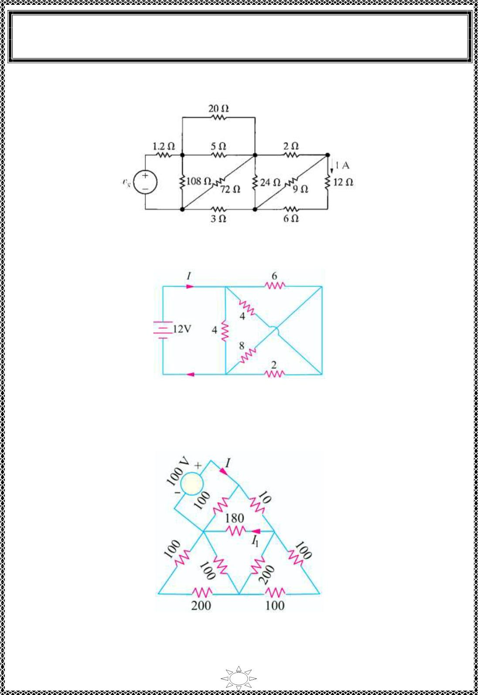
University of Diyala
Engineering College
Electronic Department
Electrical Engineering Fundamentals
1st Class
Asst., Lecturer : Wisam N. AL-Obaidi
Year (2013-2014)
H.W.(9):- The current in the 12Ω resistor of the c irc uit in Figure (2.37) is 1A. Find the
value of V_{g}.
Figure (2 .37 )
H.W.(10):- Find I the c irc uit in Figure (2.3 8).
Trail Version
Trail Version
Trail Version
Trail Version
Trail Version
Trail Version
Trail Version
Trail Version
Trail Version
Trail Version
Trail Version
Trail Version
Trail Version
[Answer : I = 6A]
Figure (2 .38 )
H.W.(11):- Find I & I₁ the circuit in Figure (2.39).
Figure (2 .39 )
[Answer : I = 2.013A, I1 =−499.3mA]
35

Slide 6
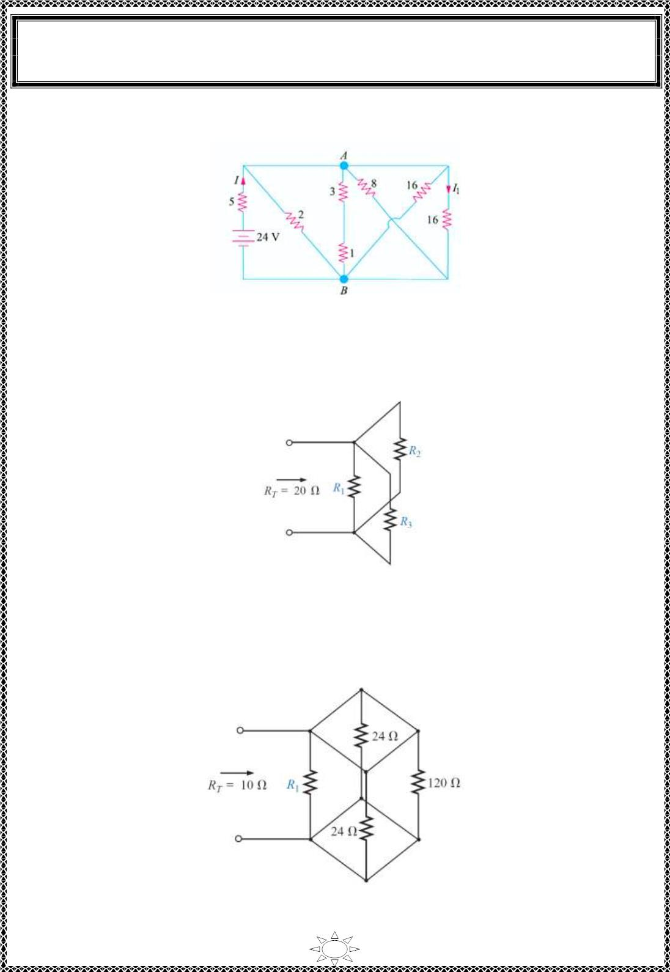
University of Diyala
Engineering College
Electronic Department
Electrical Engineering Fundamentals
1st Class
Asst., Lecturer : Wisam N. AL-Obaidi
Year (2013-2014)
H.W.(12):- In the circuit shown in Figure (2.40), c alc ula te (a) current I (b) current I₁ and
(c) V_{AB}. All resistances are in ohms. [Answer : (a) 4 A (b) 0.25 A (c) 4 V]
Figure (2.40 )
H.W.(13):- Determine the unknown res istors of Figure (2.41) given the fact that R₂ = 5R₁
and R = (1/2)R .
3
1
Trail Version
Trail Version
Trail Version
Trail Version
Trail Version
Trail Version
Trail Version
Trail Version
Trail Version
Trail Version
Trail Version
Trail Version
Trail Version
Figure (2.41 )
H.W.(14):- Determine R₁ for the network of Figure (2.42).
Figure (2.42 )
36

Slide 7
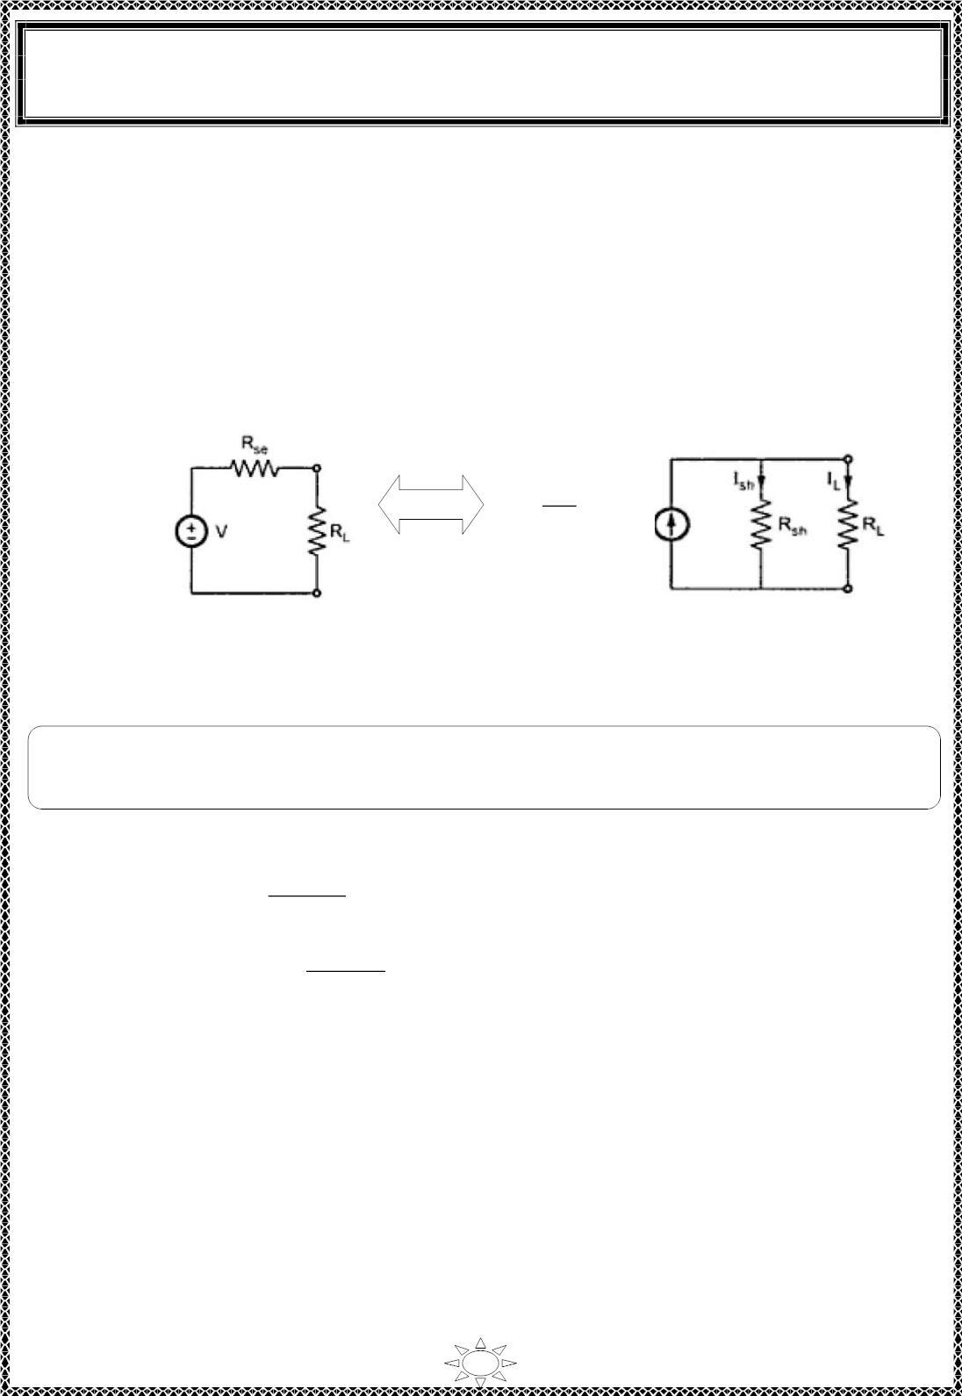
University of Diyala
Engineering College
Electronic Department
Electrical Engineering Fundamentals
1st Class
Asst., Lecturer : Wisam N. AL-Obaidi
Year (2013-2014)
Source Transformation
Consider a practical voltage source having internal resistance (R_{se}) as shown in Figure
(2.43)(a), connected to lo ad (R_{L}).
Now we can replace voltage source by equivalent current source as shown in Figure
(2.43)(b).
.
.
V
I =
^{R}se
R_{se} = R_{sh}
(a)
(b)
Trail Version
Trail Version
Trail Version
Trail Version
Trail Version
Trail Version
Trail Version
Trail Version
Trail Version
Trail Version
Trail Version
Trail Version
Trail Version
Figure (2.43 )
Note: The two sources are s aid to be equivalent, if they supply equal lo ad current to the
load, wit h same lo ad resistance connected ac ros s it' s terminals.
For (2.43 )(a),
For (2.43)(b),
I =
V
,
L
R_{se} + R_{L}
I_{L} = I ×
^{R}sh
, R_{se} = R_{sh}
R_{sh} + R_{L}
And I_{L} must be equal for both cases.
37

Slide 8
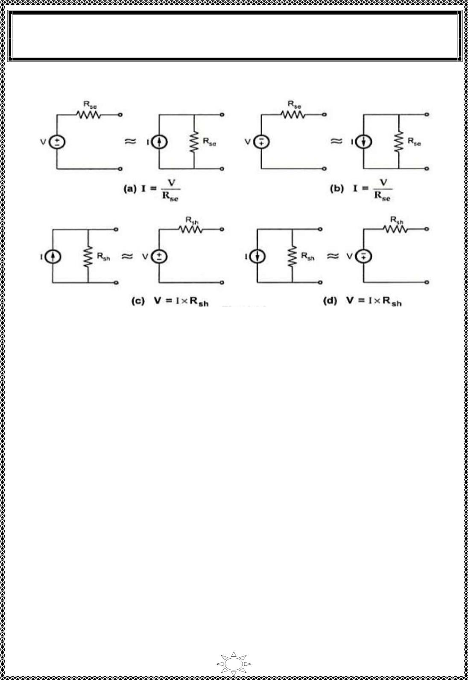
University of Diyala
Engineering College
Electronic Department
Electrical Engineering Fundamentals
1st Class
Asst., Lecturer : Wisam N. AL-Obaidi
Year (2013-2014)
Direc t ions of transformed sources, shown in Figure (2.44)(a), (b), (c) and (d).
Trail Version
Trail Version
Trail Version
Trail Version
Trail Version
Trail Version
Trail Version
Trail Version
Trail Version
Trail Version
Trail Version
Trail Version
Trail Version
Figure (2.44 )
• Practical vo ltage source has internal resistance (R_{se}) connected in series with source.
• Practical current source has internal resistance (R_{sh}) connected in parallel wit h
s ource.
• Voltage source can be converted into equivalent current source (us ing Ohm's law)
and vic e versa.
• When convert s ource, you must take into account the polar ity of sources.
When converting voltage source to current source, the current source arrow is
directed from –ve terminal to +ve t er minal of vo ltage source. While converting
current source to voltage source, polar it ies of vo ltage source is always +ve terminal
at top of current source arrow and –ve terminal at bottom of current source arrow.
• Source transformation also applies to dependent sources .
• An ideal voltage source wit h R = 0 cannot be replaced by a finite current source.
• An ideal current source wit h R = ∞ cannot be replaced by a finit e voltage source.
38

Slide 9
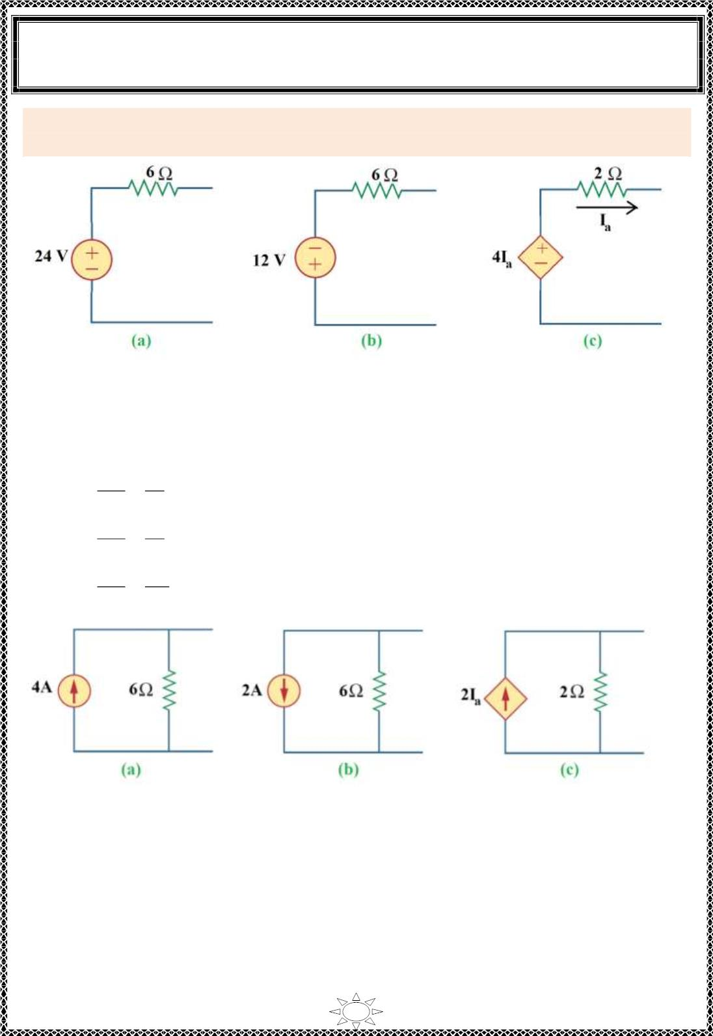
University of Diyala
Engineering College
Electronic Department
Electrical Engineering Fundamentals
1st Class
Asst., Lecturer : Wisam N. AL-Obaidi
Year (2013-2014)
Example 9: transform the ideal vo ltage sources s hown in Figure(2.45) to ideal current
sources.
Figure (2.45 )
Solution:
Trail Version
Trail Version
Trail Version
Trail Version
Trail Version
Trail Version
Trail Version
Trail Version
Trail Version
Trail Version
Trail Version
Trail Version
Trail Version
(a) I =
(b) I =
(c) I =
V
24
R_{se}
V
=
=
=
= 4 A,
= 2 A,
R = R = 6 Ω
sh se
6
12
R = R = 6 Ω
R_{se}
V
6
4I_{a}
2
sh
se
= 2I A, R = R = 2 Ω
R_{se}
a
sh
se
Figure (2.46 )
39

Slide 10
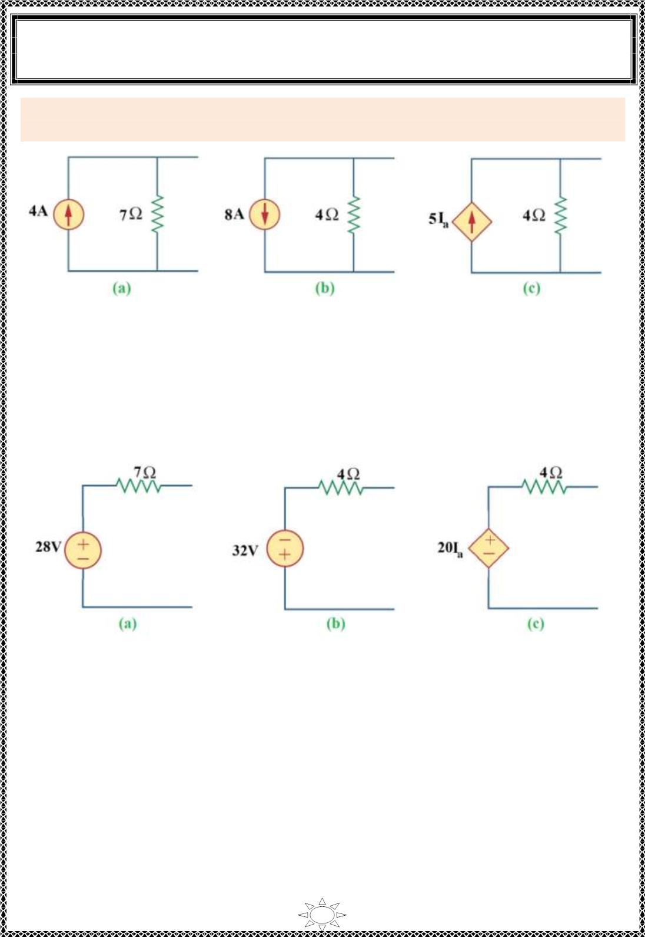
University of Diyala
Engineering College
Electronic Department
Electrical Engineering Fundamentals
1st Class
Asst., Lecturer : Wisam N. AL-Obaidi
Year (2013-2014)
Example 10: transform the ideal current sources s hown in Figure(2.7) to ideal vo ltage
sources.
Figure (2.47 )
Solution:
(a) V = I.R_{sh} = 4 × 7 = 28V,
(b) V = I.R_{sh} = 8 ×4 = 32V,
(c) V = I.R = 5I × 4 = 20I V,
R = R = 7 Ω
se sh
R = R = 4 Ω
se
sh
Trail Version
Trail Version
Trail Version
Trail Version
Trail Version
Trail Version
Trail Version
Trail Version
Trail Version
Trail Version
Trail Version
Trail Version
Trail Version
sh
a
a
R = R = 4 Ω
se
sh
Figure (2.48 )
40

